Slide 1

Stock index prices and Macroeconomic factors
Final Project _ Ironhack Bootcamp
By Esraa Ahmed

Slide 2
Content and Objective
The movement of stock index price over time and per country
The trends of major macroeconomic factors over time.
Differences in these factors from one economy to another.
The question: Can major macroeconomic factors affect the movement of stock index prices?

Slide 3
Data
Using data from Kaggle.com and World Bank.
The data covers the timeframe from 1980 to 2020.
Eight countries ( China, France, Germany, India, Japan, Spain, United Kingdom and United States of America) and one special administrative region (Hong Kong).
Consists of major macroeconomic factors and stock index price.
Notes:
- This special region related to China but worked under(one country two system) because it maintained separate political and economic system
Major macroeconomic factors such as Inflation rate, Exchange rate, Per capita income , Unemployment rate, Manufacturing output and Oil prices.
Stock index_price includes nine different stock indices.

Slide 4
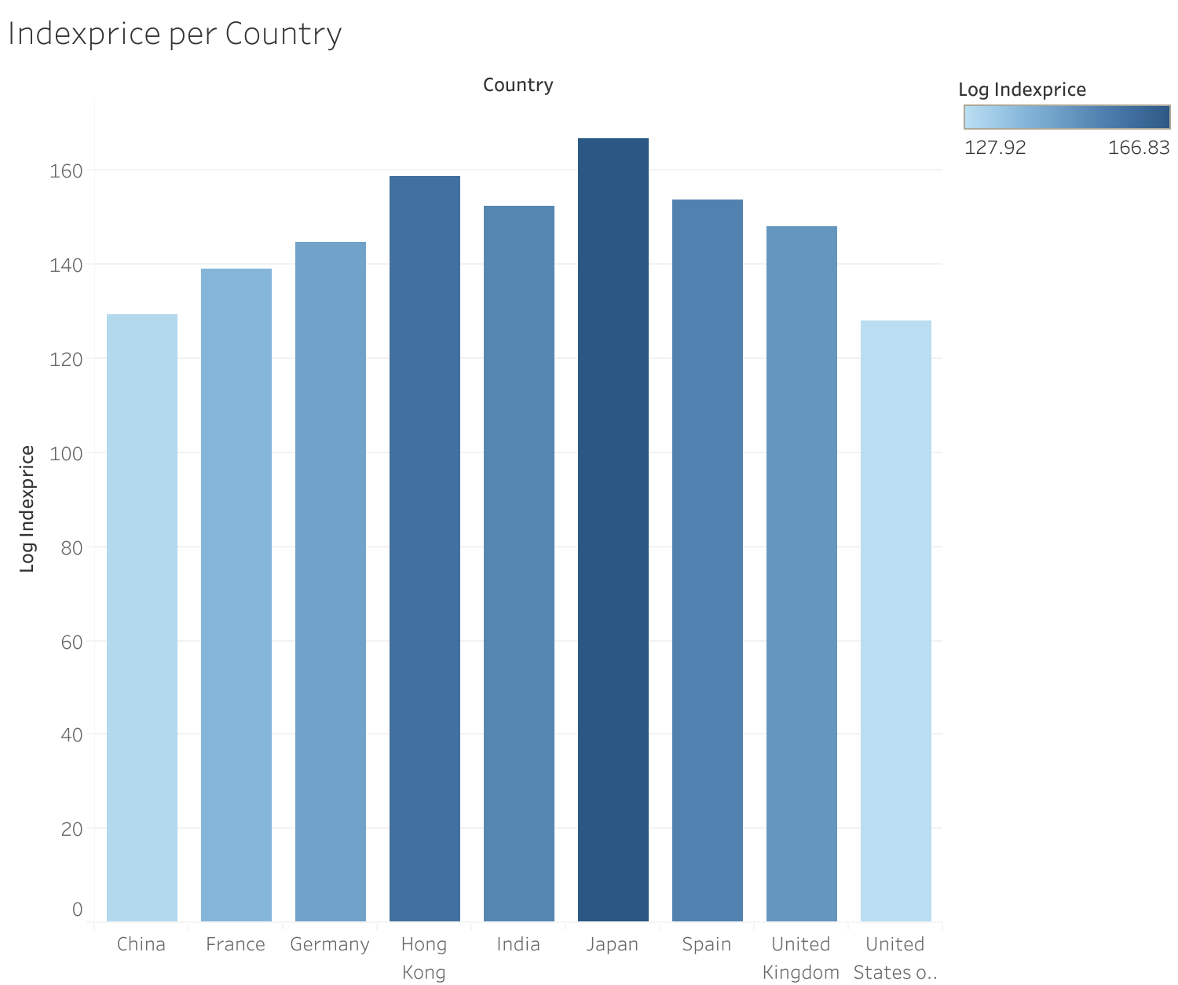
Stock index price in each country
Notes:
- Japan encounter for the highest index_price, followed by Hong Kong. While, USA has the lowest index_price compared with the other countries.

Slide 5
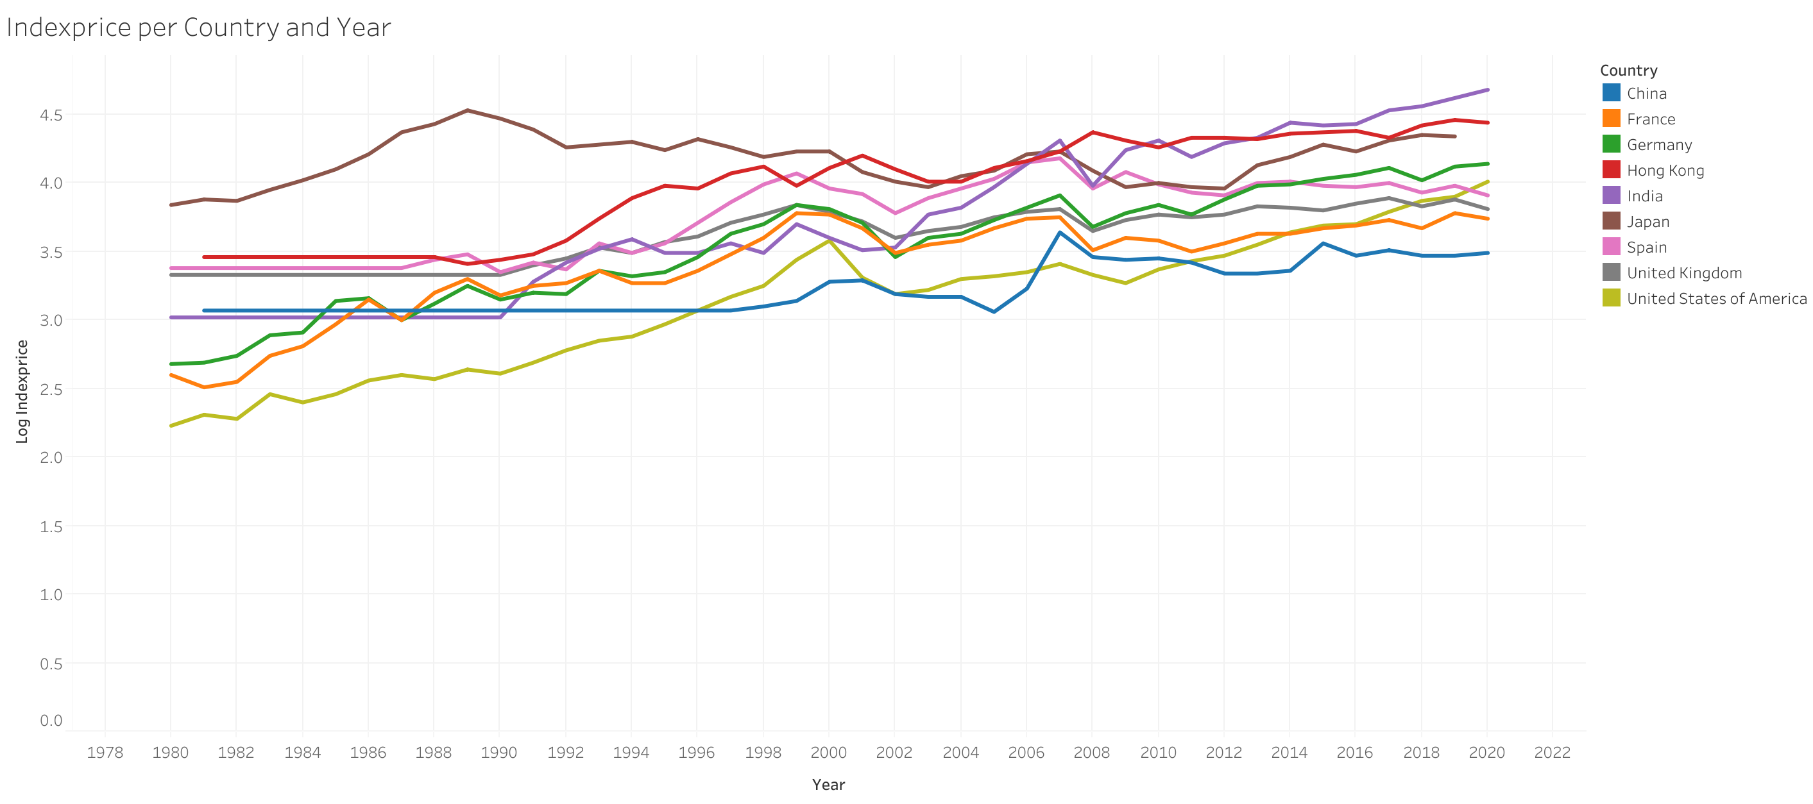
The movement of stock index price over time and per country
Notes:
- Countries followed almost the same trend over the time period of the study. Each country started at certain price and then the index_prices kept increasing slightly with some fluctuations in between.

Slide 6
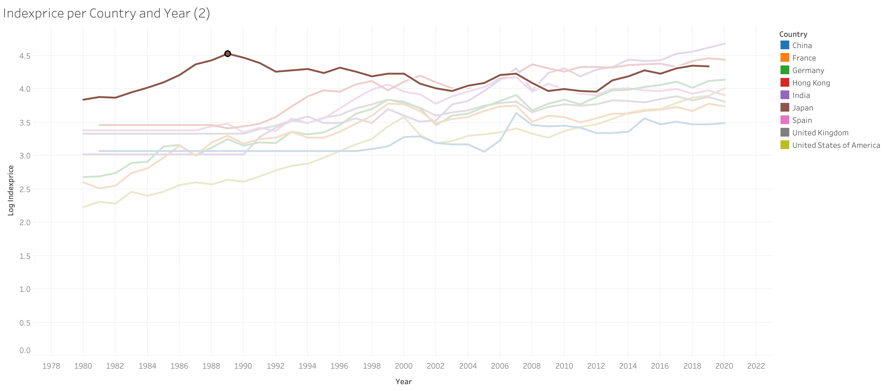
The movement of stock index price over time and per country

Slide 7
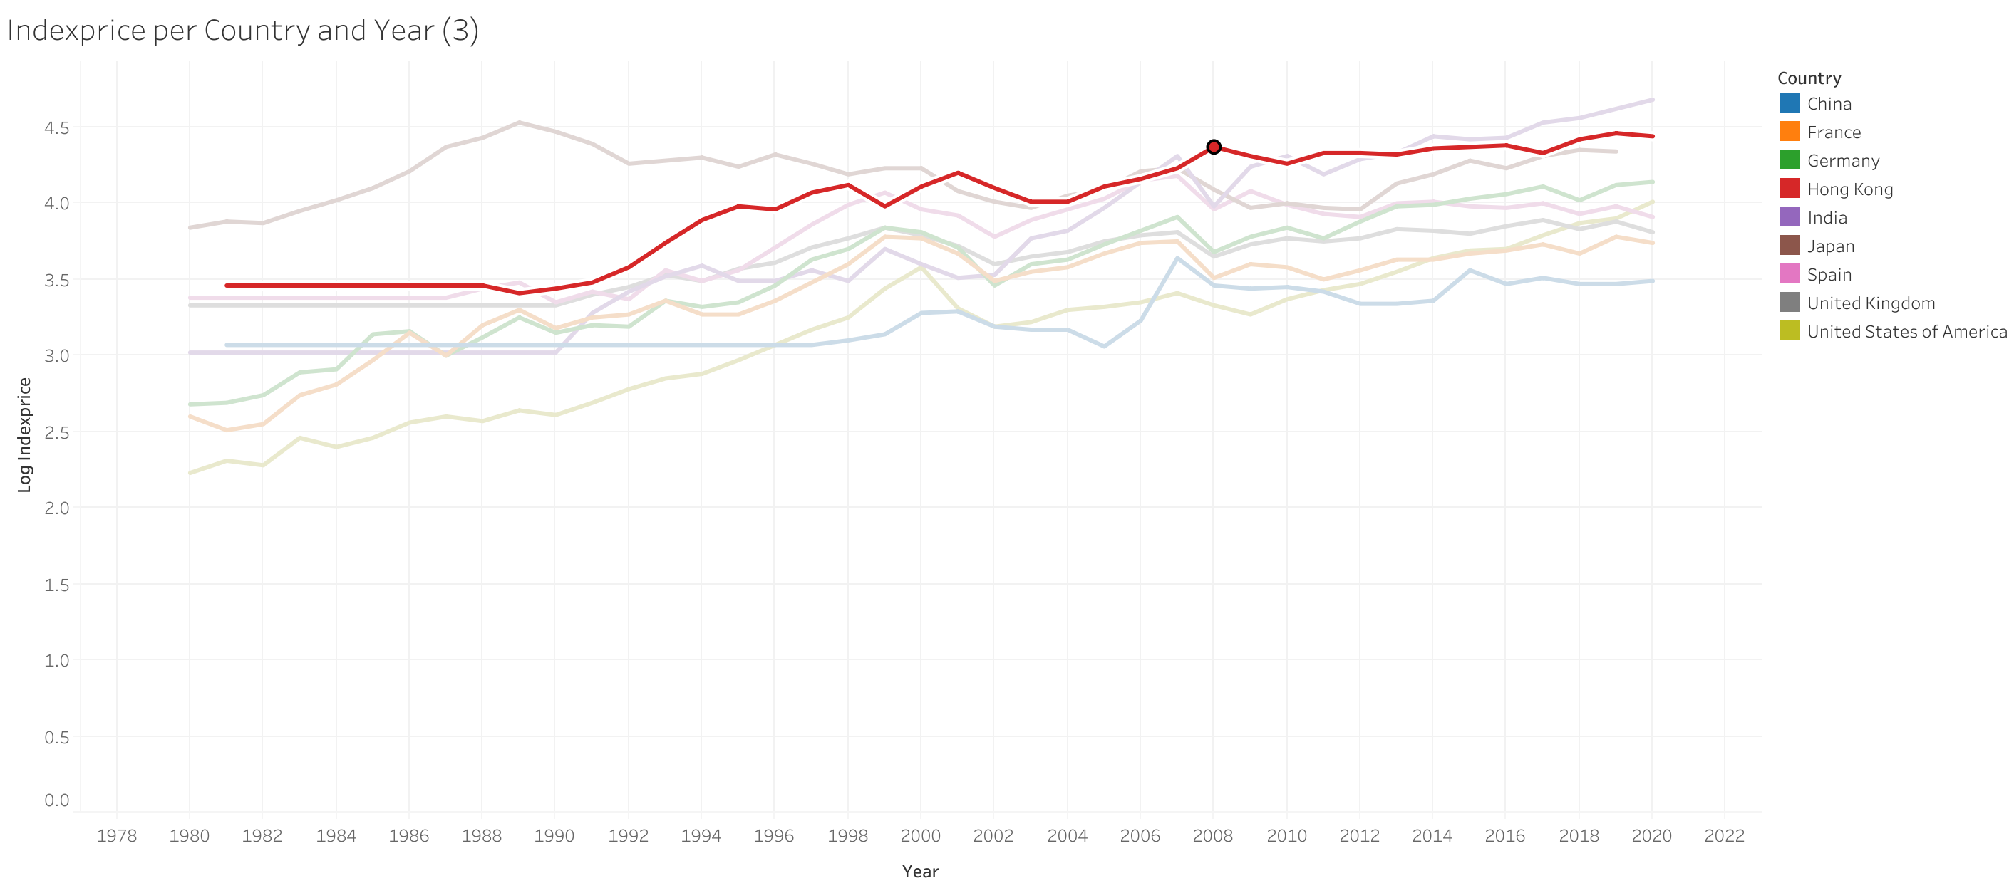
The movement of stock index price over time and per country

Slide 8

Differences in these factors from one economy to another

Slide 9
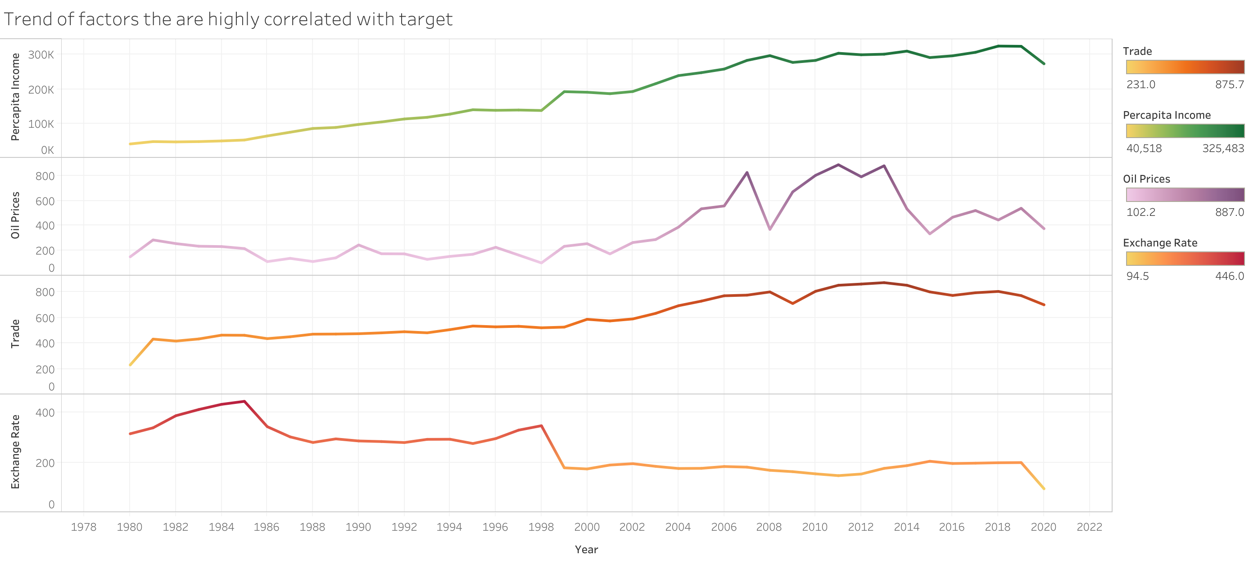
Trends of major macroeconomic factors over time
Notes:
Focusing here on factors that are highly correlated with our target, there is a common positive trend over time.
Oil prices witnessed more fluctuations between 2007 and 2015, as there were the two major drops in oil prices, in 2008 at the time of financial crisis and the great recession and again in mid 2014.

Slide 10
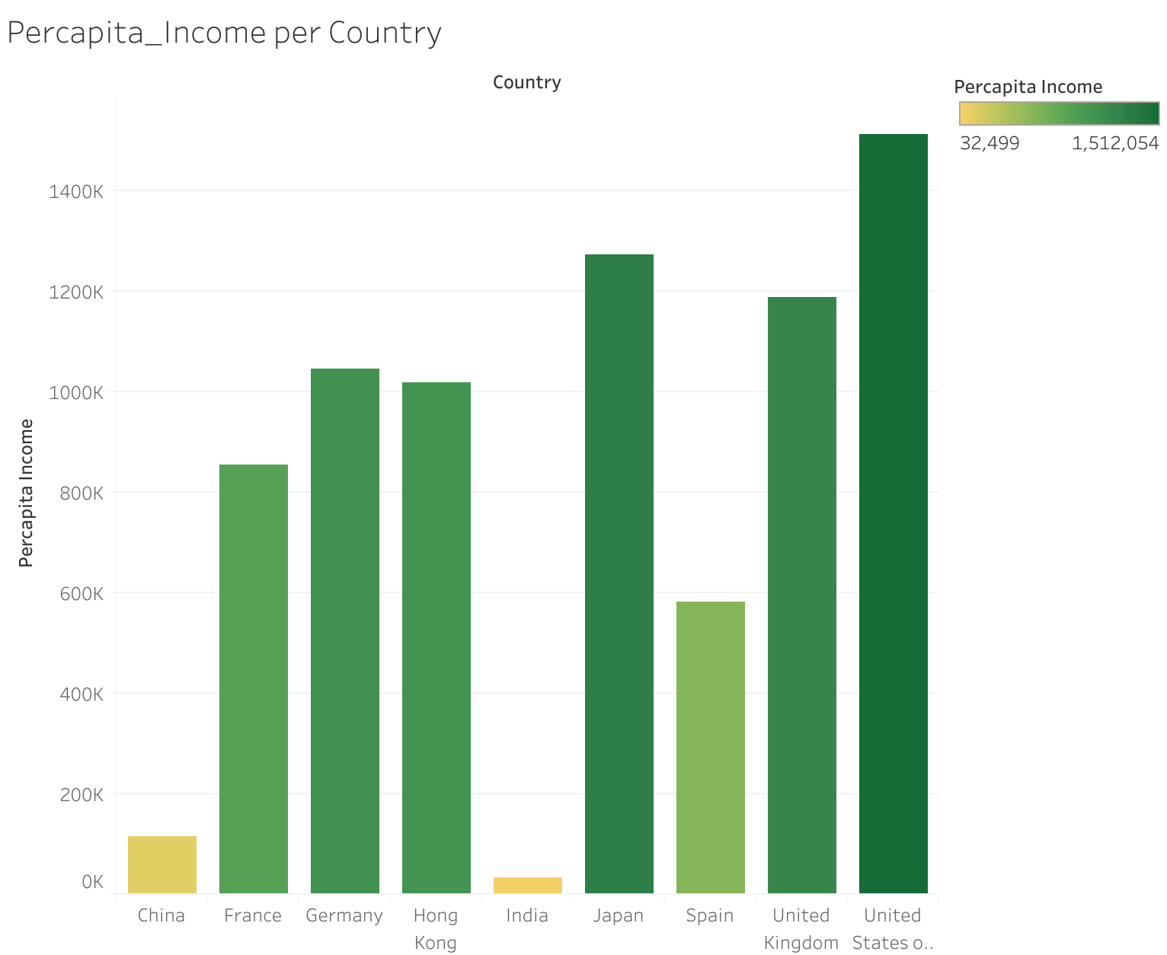
Percapita_Income

Slide 11
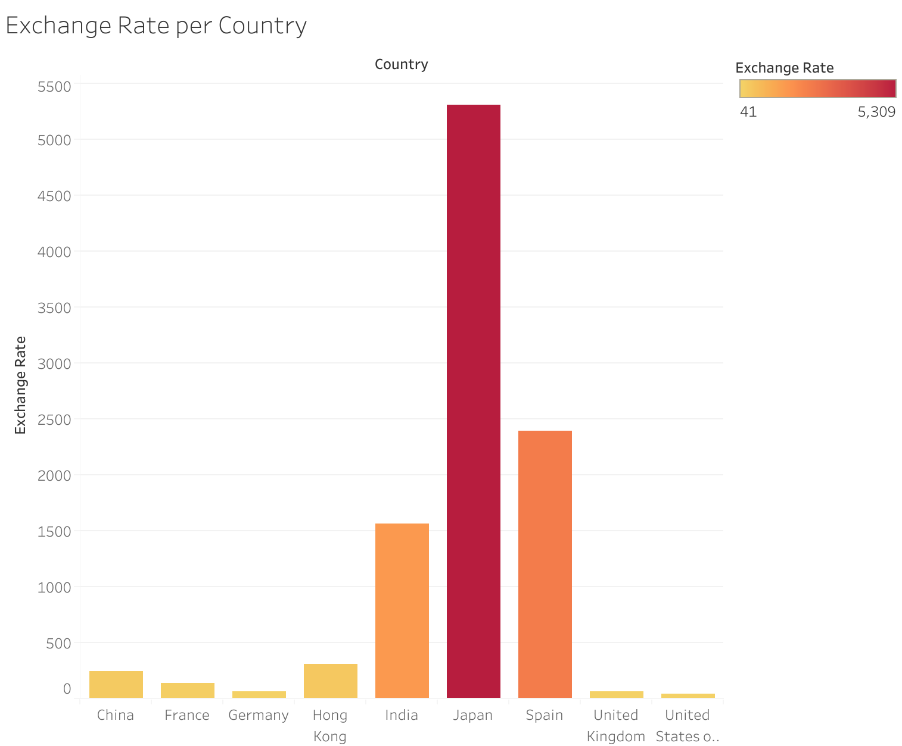
Exchange Rate

Slide 12
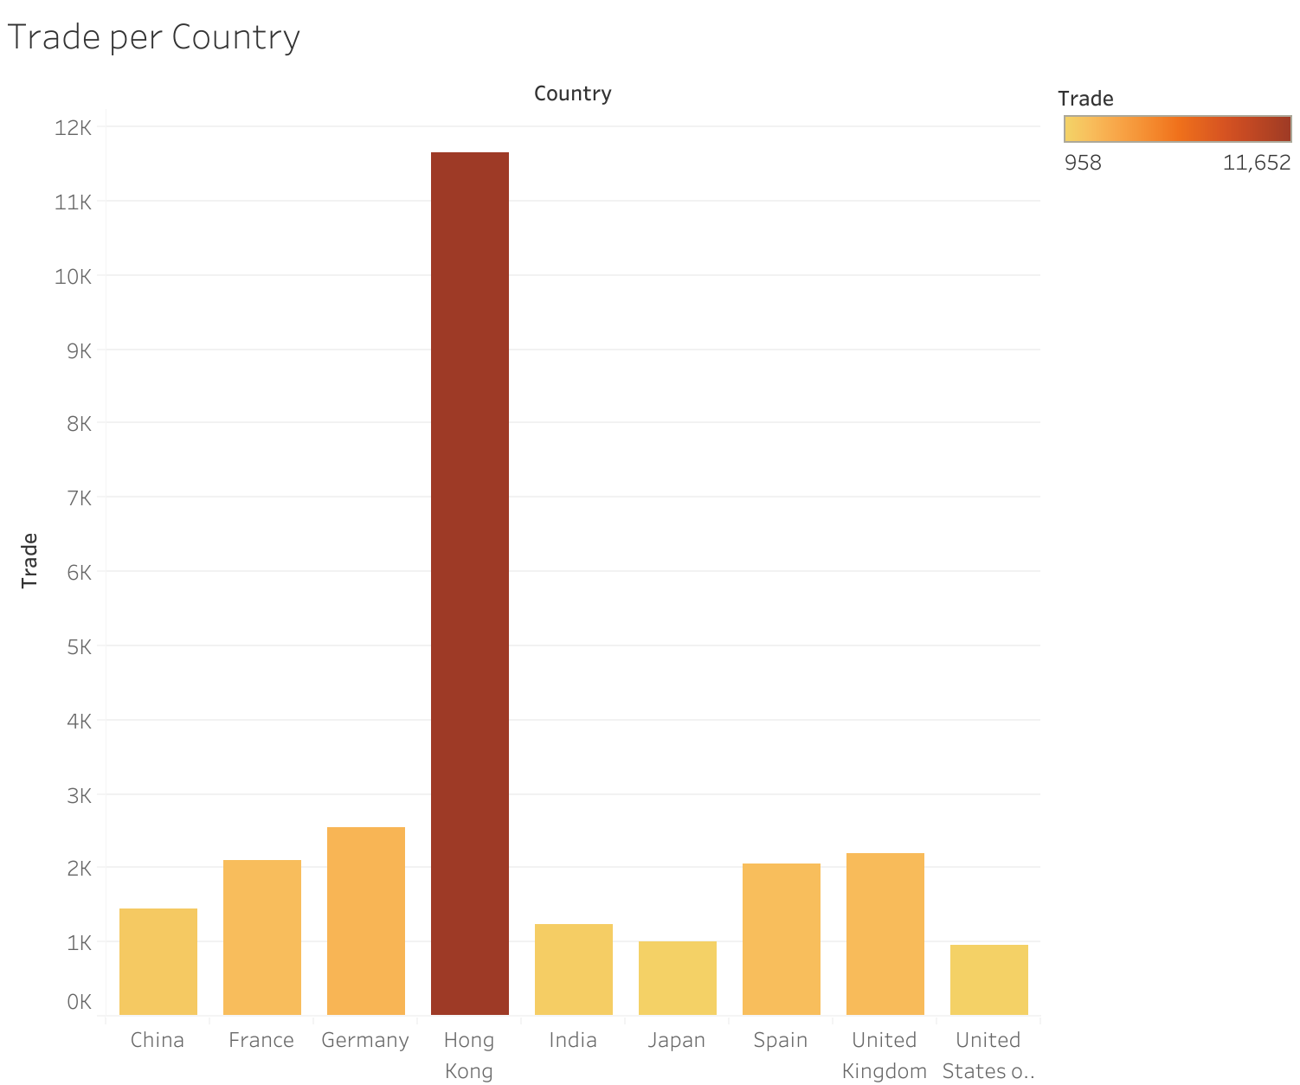
Trade

Slide 13
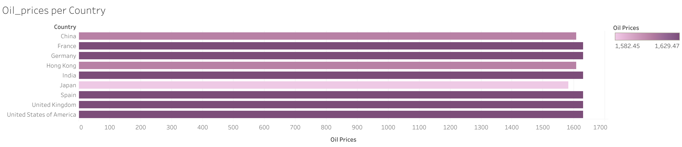
Oil prices

Slide 14

How major macroeconomic factors can impact the movement of stock index prices

Slide 15
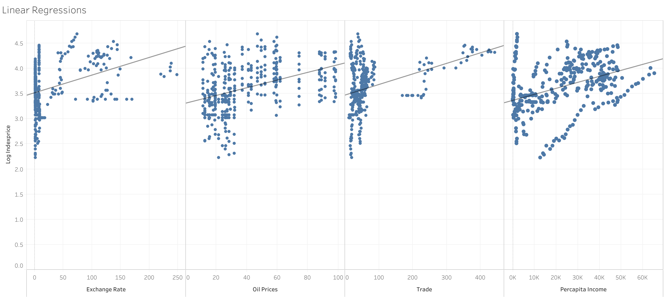
Correlation between Index_price and the factors

Slide 16
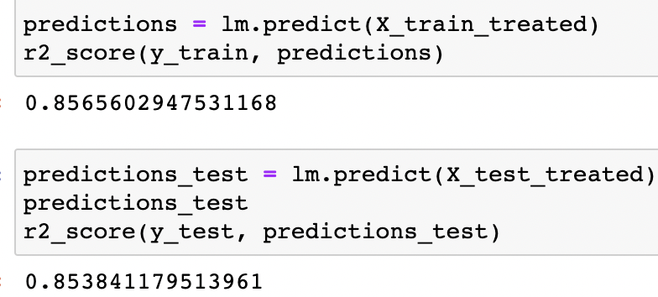
The Model
The score of linear regression model is 0.853
Most of the factors included in the model have a good correlation with the target.
These factors have significant effect on the changing of stock index price.

Slide 17
Compared with other Models
Decision Tree Regressor: 0.39
Linear Regression: 0.80
KNN: 0.53
Random Forest: 0.68
MLP_reg: 0.62
Decision Tree Regressor: 0.85
Linear Regression: 0.83
KNN: 0.93
Random Forest: 0.93
MLP_reg: 0.77
Notes:
Test set is on the left and train set is on the right
Linear regression score here after including the cross validation

Slide 18

Conclusion and useful Insights
The relationship between stock indices and macroeconomic factors include some ambiguity.
Should pay attention to that the impact can also come from the target .
Not all the factors have a direct relationship with the target.

Slide 19
Thank you

